Slide 1
Energy for Single-Family Homes: What You Need to Know
ADD NAME HERE
ADD EVENT HERE
ADD DATE HERE
Notes:
Be sure to update your contact information and the date on this slide. ☺

Slide 2
Today’s Workshop

Slide 4
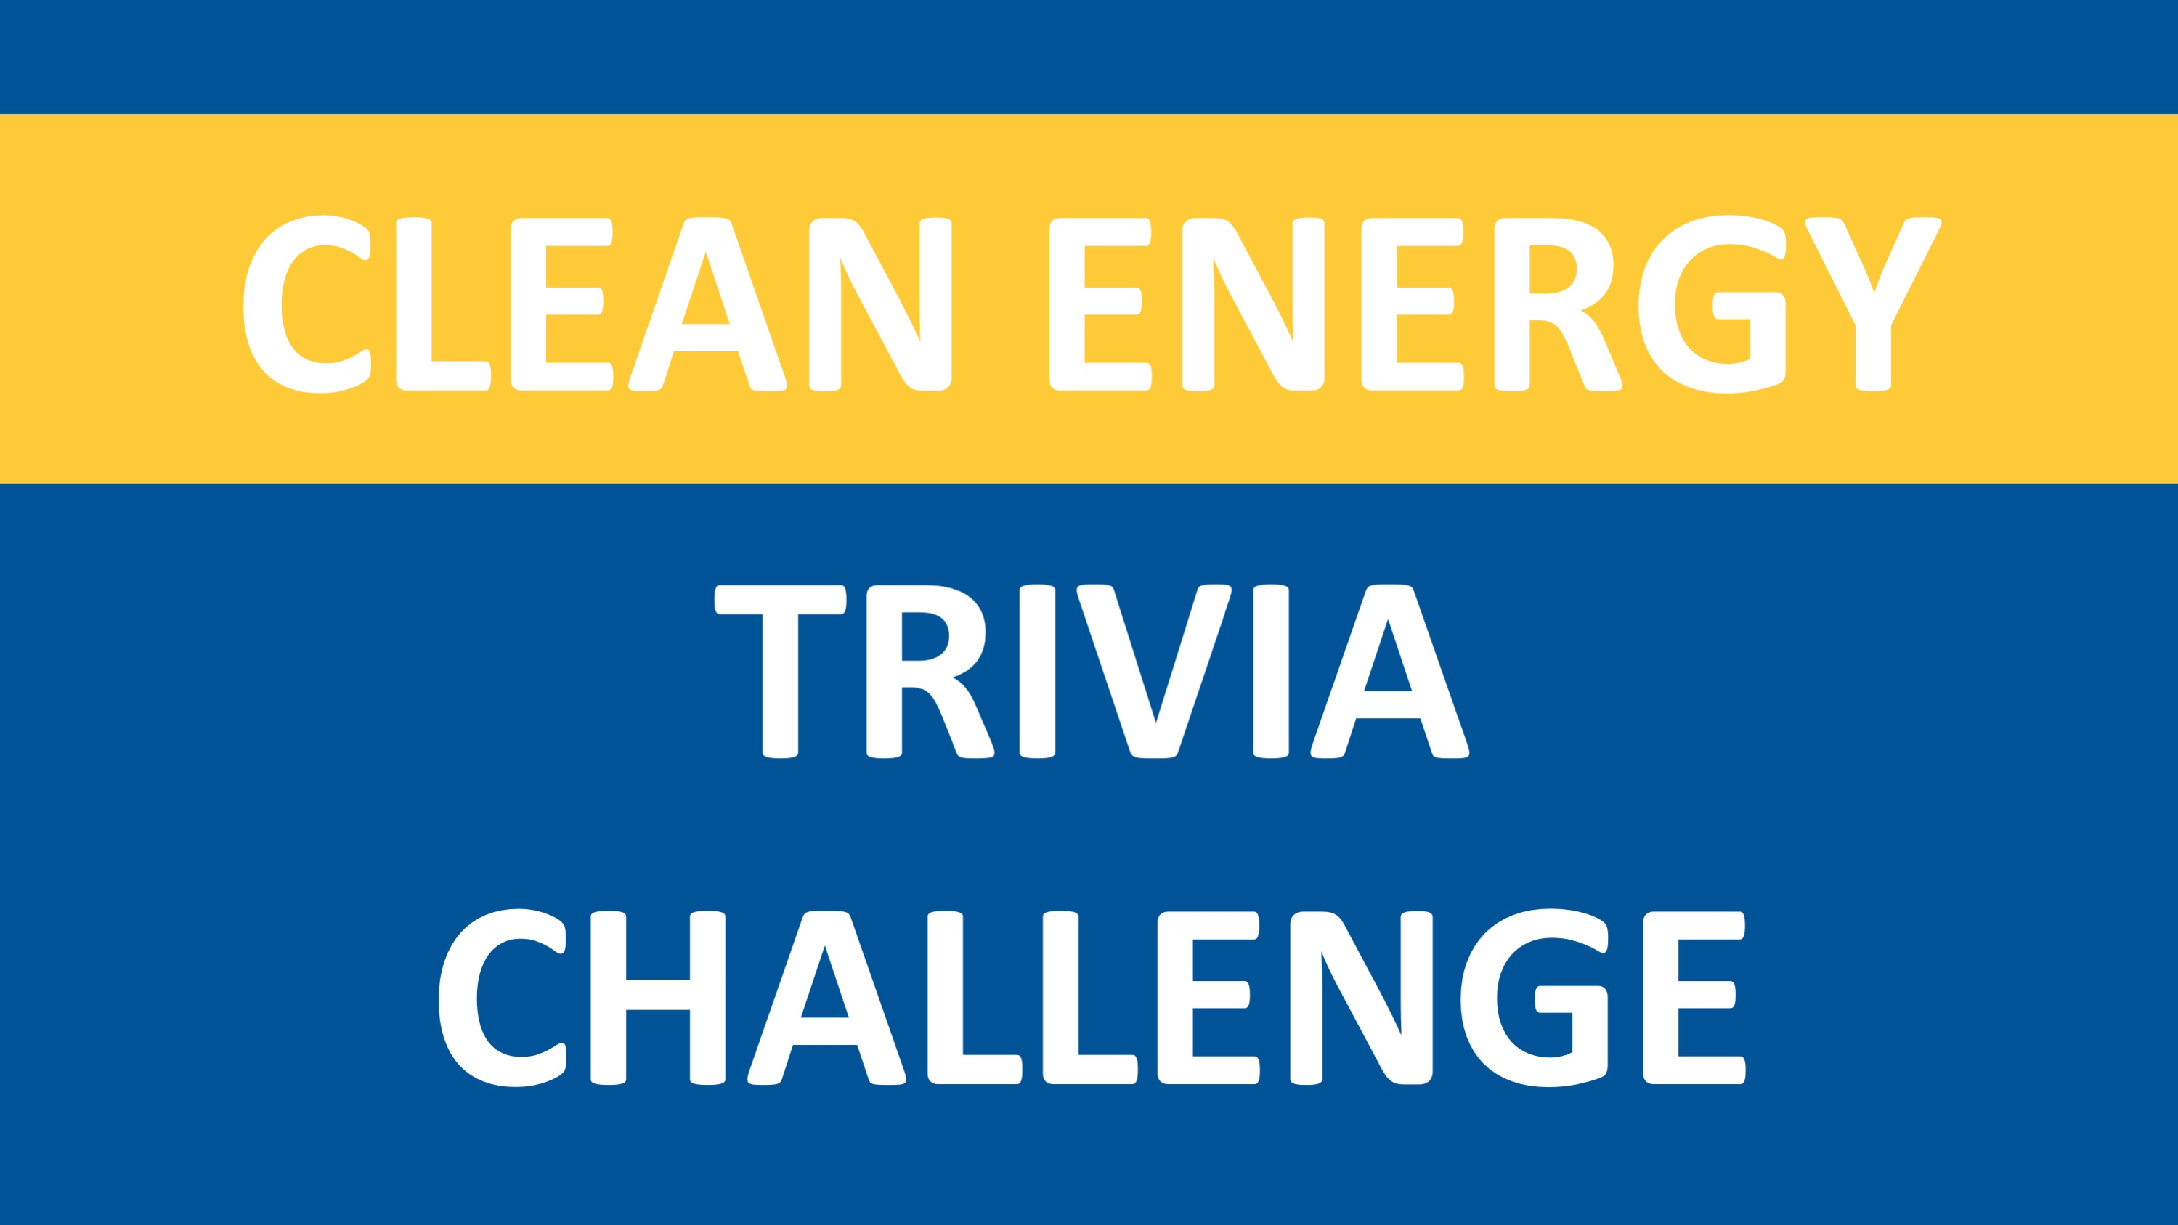

Slide 26
Notes:
A tool to help you choose the right light bulb, outlining:
Differences between the types of bulbs available
How to identify the brightness of bulbs
How to read the new labels
Cost comparison between bulbs
AND there’s an APP for that!

Slide 29
Notes:
Minnesota’s Cold Weather Rule (CWR) is a state law that protects residential utility customers from having electric or natural gas service shut off between October 1 and April 30. You are eligible for CWR protection even if you rent – the electricity or gas must be the primary heat source and the utility account must be in your name.
You and your utility must agree to a payment plan that is reasonable for your household. You can set up a CWR payment plan any time during the CWR season.
All natural gas and electric utilities must offer CWR protection. CWR does not apply to delivered fuels; oil and propane or wood. If you use delivered fuels, and your furnace is run by electricity, you should apply for CWR protection with your electric company.
Call your natural gas, electric, municipal utility or electric cooperative for more information, or contact the Commission’s Consumer Affairs Office at consumer.puc@state.mn.us or 651-296-0406, 1-800-657-3782.

Slide 31
Notes:
Manual thermostats
The traditional dial type of thermostat has worked for many years to control the heating and cooling of homes. It holds the set tempera- ture and the home stays at that temperature until someone changes it. Often the settings are left at levels that are comfortable for peo- ple—even at night or when nobody is home— thus wasting energy. Manual thermostats may work best with electric resistance heat, radiant in-floor heat, heat pumps, and steam heat.
Programmable thermostats
Programmable thermostats allow users to change the temperature of the home based on the time of day and whether they are home or asleep. A digital programmable thermostat allows the settings to be changed or set at the thermostat itself, usually through a touch screen interface. Depending on the model, there may be up to four different modes avail- able for each day: morning, day, evening, and night. The desired times for these modes can be selected, along with the desired tempera- ture. Additionally, some models allow you to have different settings for weekdays and week- ends. All programmable thermostats allow for
overriding the programmed setting, to provide extra heating or cooling, for example, and most have a special setting for vacations. Additional- ly, most models can also control air exchangers, humidifiers, heat pumps, and other devices.
Smart thermostats
Smart thermostats operate essentially the same as programmable models, with one significant difference: they “learn” the preferences of occupants and adjust temperatures according to whether or not anyone is actually at home. Addi- tionally, they are Wi-Fi enabled, allowing users to control settings through a smart phone app or computer. Monthly e-mail reports on usage and suggestions for energy savings are also included in most models. Finally, some are also linked with home security systems, providing remote monitoring and operation of many home functions.

Slide 43
Notes:
Repairs can be made with caulk, glazing compound, wood putty, epoxy, or spray foam, depending on the location.
Weather-stripping—tubular weather stripping is best insulator but requires more closing pressure; for less closing pressure, do neoprene, urethane, silicone, or rubber weather-stripping.
Sash and frame construction – solid steel and aluminum are poor insulators. Wood or vinyl is better. Fiberglass or wood clad are best.

Slide 52
Notes:
Community Solar Gardens are centrally-located solar photovoltaic (PV) systems that provide electricity to participating subscribers. Community solar gardens are for people that want to go solar but are unable to do so on their own. Perhaps you live in an apartment, have a shaded roof at home, or don’t have space at your organization. Now you can subscribe to a community solar garden installed near you and get credits on your utility bill.

Slide 54
Notes:
The Clean Energy Resource Teams—or CERTs—are a statewide partnership with a shared mission to connect individuals and their communities to the resources they need to identify and implement community-based clean energy projects. We empower communities and their members to adopt energy conservation, energy efficiency, and renewable energy technologies and practices for their homes, businesses, and local institutions.

